Slide 1
Inflation: Its Causes, Effects, and Social Costs
Chapter 5

Slide 2
IN THIS CHAPTER, YOU WILL LEARN:
The classical theory of inflation
  causes
  effects
  social costs
“Classical” – assumes prices are flexible & markets clear
Applies to the long run
1

Slide 3
U.S. inflation and its trend,
1960–2012
% change in
GDP deflator

Slide 4
U.S. inflation and its trend,
1960–2012
long-run trend
Notes:
…the long-run trend behavior of inflation. We will learn a simple theory of inflation over the long run and see that its predictions are very consistent with U.S. and international data.

Slide 5
Italian inflation and its trend,
1961–2012
% annual change in CPI
long-run trend
Notes:
Source: OECD, Consumer prices (MEI), Annual inflation (all items, non-food non-energy)

Slide 6
The quantity theory of money
A simple theory linking the inflation rate to the growth rate of the money supply.
Money demand for transactions
Begins with the concept of velocity…

Slide 7
Velocity
basic concept:
the rate at which money circulates
definition: the number of times the average euro coin changes hands in a given time period
example: In 2012,
  €500 billion in transactions
  money supply = €100 billion
  The average euro is used in five transactions in 2012
  So, velocity = 5

Slide 8
Velocity, cont.
This suggests the following definition:
where
V = velocity
T = value of all transactions
M = money supply

Slide 9
Velocity, cont.
Use nominal GDP as a proxy for total transactions.
Then,
where
P = price of output (GDP deflator)
Y = quantity of output (real GDP)
P × Y = value of output (nominal GDP)
Notes:
What is the difference between nominal GDP and the value of transactions?
Answer: nominal GDP includes the value of purchases of final goods; total transactions also includes the value of intermediate goods.
Even though they are different, they are highly correlated. Also, our models focus on GDP, and there’s lots of great data on GDP. So from this point on, we’ll use the income version of velocity.

Slide 10
The quantity equation
The quantity equation
M × V = P × Y
follows from the preceding definition of velocity.
It is an identity:
it holds by definition of the variables.

Slide 11
Money demand (for transactions) and the quantity equation
M/P = real money balances, the purchasing power of the money supply.
A simple money demand function:
(M/P )^{d} = k Y
where
k = how much money people wish to hold for each euro of income.
(k is exogenous)

Slide 12
Money demand and the quantity equation
money demand: (M/P )^{d} = k Y
quantity equation: M × V = P × Y
The connection between them: k = 1/V
When people hold lots of money relative
to their incomes (k is large),
money changes hands infrequently (V is small).

Slide 13
Back to the quantity theory of money
starts with quantity equation
assumes V is constant & exogenous:
Then, quantity equation becomes:

Slide 14
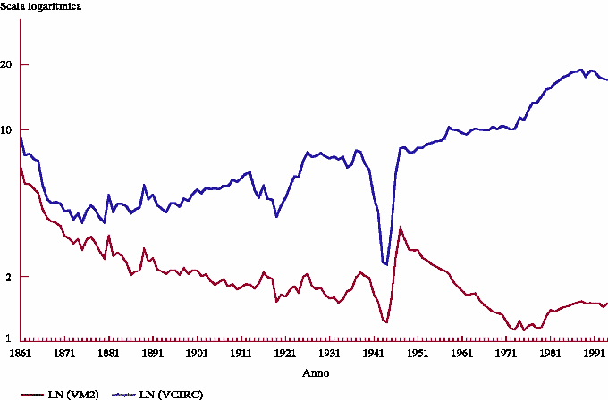
Velocity of money in Italy, 1861-1992

Slide 15
The quantity theory of money, cont.
How the price level is determined:
  With V constant, the money supply determines nominal GDP (P × Y ).
  Real GDP is determined by the economy’s supplies of K and L and the production function (Chap. 3).
  The price level is
  P = (nominal GDP)/(real GDP).

Slide 16
The quantity theory of money, cont.
Recall from Chapter 2:
The growth rate of a product equals
the sum of the growth rates.
The quantity equation in growth rates:

Slide 17
The quantity theory of money, cont.
π (Greek letter pi )
denotes the inflation rate:
The result from the
preceding slide:
Solve this result
for π:

Slide 18
The quantity theory of money, cont.
Economic growth requires a certain amount of money supply growth to facilitate the growth in transactions.
Money growth in excess of this amount leads to inflation.
Simplified classical theory: Y is given (it depends on F, K and L, which are given), so

Slide 19
The quantity theory of money, cont.
ΔY/Y depends on growth in the factors of
production and on technological progress
(all of which we take as given, for now).
Hence, the quantity theory predicts
a one-for-one relation between
changes in the money growth rate and
changes in the inflation rate.

Slide 20
Confronting the quantity theory with data
The quantity theory of money implies:
  1. Countries with higher money growth rates
  should have higher inflation rates.
  2. The long-run trend in a country’s inflation rate should be similar to the long-run trend in the country’s money growth rate.
Are the data consistent with these implications?

Slide 21
International data on inflation and money growth
Inflation rate
(percent)
Belarus
Zambia
Iraq
Serbia
Turkey
Suriname
Mexico
U.S.
Russia
Malta
Cyprus
China
Money supply growth
(percent)
Notes:
Each variable is measured as an annual average over the period 2000-2010.
The strong positive correlation is evidence for the quantity theory of money.
Source:
Money Supply Data - www.imf.org > Data > International Financial Statistics (IFS)
Inflation Data - www.imf.org > Data > World Economic Outlook

Slide 22
U.S. inflation and money growth,
1960–2012
M2 growth rate
inflation rate
Notes:
source:
Federal Reserve Bank of St. Louis
http://research.stlouisfed.org/fred2/
M2SL (percent change from year ago, quarterly aggregation method average)
GDPDEF (percent change from year ago)

Slide 23
U.S. inflation and money growth,
1960–2012
Inflation and money growth
have the same long-run trends,
as the quantity theory predicts.
Notes:
The quantity theory of money is intended to explain the long-run relation of inflation and money growth, not the short-run relation. In the long run, inflation and money growth are positively related, as the theory predicts.
(In the short run, however, inflation and money growth appear highly negatively correlated! One possible reason is that the causality is reversed in the short run: when inflation rises – or is expected to rise – the Fed cuts back on money growth. If the economy slumps and inflation falls, the Fed increases money growth.
source:
Federal Reserve Bank of St. Louis
http://research.stlouisfed.org/fred2/
M2SL (percent change from year ago, quarterly aggregation method average)
GDPDEF (percent change from year ago)

Slide 24
Seigniorage
To spend more without raising taxes or selling bonds, the govt can print money.
The “revenue” raised from printing money
is called seigniorage
The inflation tax:
Printing money to raise revenue causes inflation. Inflation is like a tax on people who hold money.
Notes:
In the U.S., seigniorage accounts for only about 3% of total government revenue. In Italy and Greece, seigniorage has often been more than 10% of total revenue. In countries experiencing hyperinflation, seigniorage is often the government’s main source of revenue, and the need to print money to finance government expenditure is a primary cause of hyperinflation.
See Case Study on p.109 “Paying for the American Revolution.”

Slide 25
Inflation and interest rates
Nominal interest rate, i
not adjusted for inflation
Real interest rate, r
adjusted for inflation:
r = i − π

Slide 26
The Fisher effect
The Fisher equation: i = r + π
Chap. 3: S = I determines r .
Hence, an increase in π
causes an equal increase in i.
This one-for-one relationship
is called the Fisher effect.

Slide 27
U.S. inflation and nominal interest rates,
1960–2012
nominal interest rate
inflation rate
Notes:
The data are consistent with the Fisher effect: inflation and the nominal interest rate are very highly correlated.
That they are not perfectly correlated does not contradict the Fisher effect. Over time, the saving and investment curves (see Chapter 3) move around, changing the real interest rate, which, in turn, causes the nominal interest rate to change for a given value of inflation.
About the data:
The inflation rate is the percentage change in the CPI from 12 months earlier.
(CPIAUCSL, monthly, percent change from year ago)
The nominal interest rate is the 3-month Treasury bill rate in the secondary market (TB3MS, monthly)
Data obtained from http://research.stlouisfed.org/fred2/

Slide 28
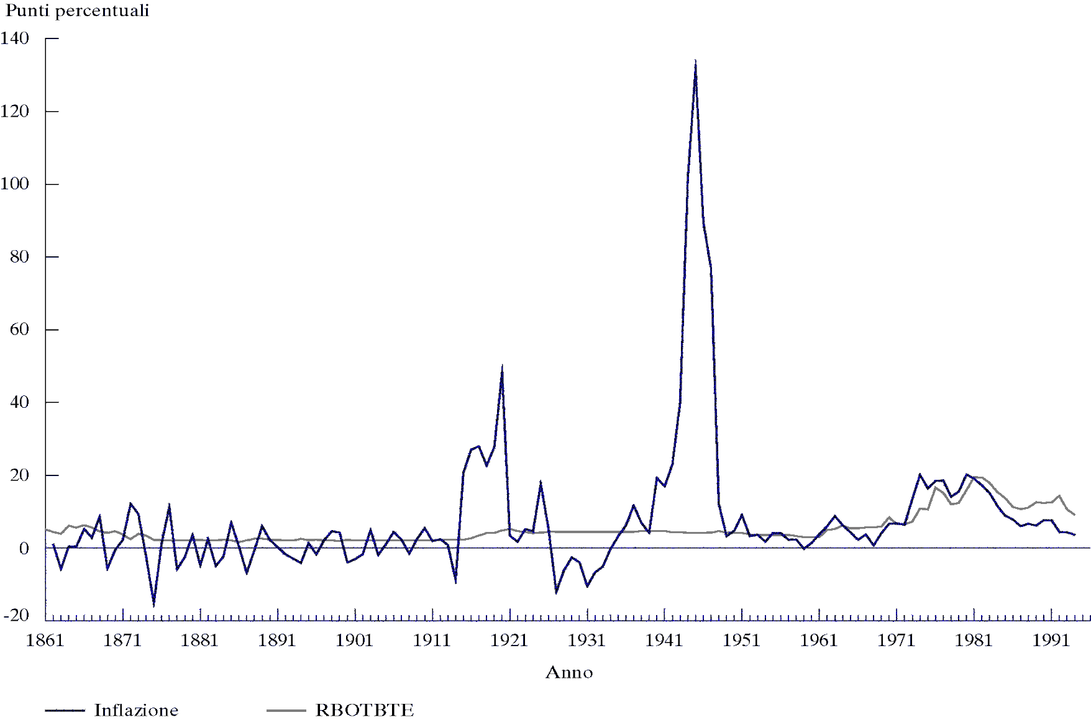
Italian inflation and nominal interest rates,
1861-1992
Gold standard 1861-1973, with an interruption between the two world wars

Slide 29
Inflation and nominal interest rates in 96 countries
Nominal
interest rate
(percent)
Turkey
Georgia
Malawi
Ghana
Mexico
Brazil
Poland
Iraq
U.S.
Japan
Kazakhstan
Inflation rate
(percent)
Notes:
Sources:
Interest Rate Data - www.imf.org > Data > International Financial Statistics (IFS)
Inflation Data - www.imf.org > Data > World Economic Outlook
Each variable is measured as an annual average over 2000-2010.
The nominal interest rate is the rate on short-term government debt.

Slide 30
EXERCISE:
Applying the theory
Suppose V is constant, M is growing 5% per year,
Y is growing 2% per year, and r = 4.
  a. Solve for i.
  b. If the CB increases the money growth rate by
  2 percentage points per year, find Δi.
  c. Suppose the growth rate of Y falls to 1% per year.
    What will happen to π ?
    What must the CB do if it wishes to
    keep π constant?
29

Slide 31
ANSWERS
Applying the theory
V is constant, M grows 5% per year,
Y grows 2% per year, r = 4.
  a. First, find π = 5 − 2 = 3.
  Then, find i = r + π = 4 + 3 = 7.
  b. Δi = 2, same as the increase in the money growth rate.
  c. If the Fed does nothing, Δπ = 1.
  To prevent inflation from rising,
  the CB must reduce the money growth rate by
  1 percentage point per year.
30
Notes:
Answers, the details:
First, we need to find π.
Constant velocity implies π = (ΔM/M) - (ΔY/Y) = 5 – 2 = 3.
Then, i = r + π = 4 + 3 = 7.
b. Changes in the money growth rate do not affect real GDP or its growth rate. So, a two-point increase in money growth causes a two-point increase in inflation. According to the Fisher effect, the nominal interest rate should rise by the increase in inflation: two points (from i = 7 to i = 9).
c. π = (ΔM/M) – (ΔY/Y). If (ΔY/Y) falls by 1 point, then π will increase by 1 point; the CB can prevent this by reducing (ΔM/M) by 1 point. Intuition: With slower growth in the economy, the volume of transactions will be growing more slowly, which means that the need for new money will grow more slowly.

Slide 32
Two real interest rates
Notation:
π = actual inflation rate
(not known until after it has occurred)
Eπ = expected inflation rate (N.B. in book expected inflation rate= π^{e} )
Two real interest rates:
i – Eπ = ex ante real interest rate:
the real interest rate people expect
at the time they buy a bond or take out a loan
i – π = ex post real interest rate:
the real interest rate actually realized

Slide 33
Money demand (store of value) and the nominal interest rate
In the quantity theory of money, the demand for real money balances depends only on Y.
Holding money has an opportunity cost:
  forgone real interest r on loans (bonds or other interest-earning assets)
  the purchasing power of M is reduced by π
Expected opportunity cost of holding money:
i = r + Eπ
Hence, ↑i ⇒ ↓ in money demand.
Notes:
The concept of “money demand” can be a bit awkward for students the first time they learn it. A good way to explain it is to imagine that a consumer has a certain amount of wealth, which is divided between money and other assets. The other assets typically generate some type of income (e.g. interest income in the case of bonds), but are much less liquid than money. There is therefore a trade-off: the more money the consumer holds in his portfolio, the more interest income he foregoes; the less money he holds, the more interest income he makes, but the less liquid is his portfolio.
With this for background, a consumer’s “money demand” refers to the fraction of his wealth he would like to hold in the form of money (as opposed to less-liquid income-generating assets like bonds).

Slide 34
The money demand function
(M/P )^{d} = real money demand, depends
  negatively on i
    i is the opp. cost of holding money
  positively on Y
    higher Y ⇒ more spending
    ⇒ so, need more money
(“L” is used for the money demand function because money is the most liquid asset.)
Notes:
An increase in the nominal interest rate represents the increase in the opportunity cost of holding money rather than bonds, and would motivate the typical consumer to hold less of his wealth in the form of money, and more in the form of bonds (or other interest-earning assets).
An increase in real income (other things equal) causes an increase in the consumer’s consumption and therefore spending. To facilitate this extra spending, the consumer will require more money. Thus, the consumer would like a larger fraction of his wealth to be in the form of money (rather than bonds, etc.). This might involve redeeming/selling. some of his bonds. Or it might simply involve holding the additional income in the form of money rather than putting it into bonds.

Slide 35
The money demand function
When people are deciding whether to hold money or bonds, they don’t know what inflation will turn out to be.
Hence, the nominal interest rate relevant for money demand is r + Eπ.

Slide 36
Equilibrium
The supply of real money balances
Real money demand

Slide 37
What determines what
variable how determined (in the long run)
M exogenous (Fed/ECB)
r adjusts to ensure S = I
Y
P adjusts to ensure
Notes:
Again, it is very important for students to learn the logical order in which variables are determined. I.e., we do not need to know P in order to determine Y. We do need to know Y in order to determine L, and we need to know L and M in order to determine P.

Slide 38
How P responds to ΔM
For given values of r, Y, and Eπ ,
a change in M causes P to change by the same percentage—just like in the quantity theory of money.
Notes:
This slide shows the connection between the money market equilibrium condition and the (simpler) quantity theory of money, presented earlier in this chapter.

Slide 39
What about expected inflation?
Over the long run, people don’t consistently
over- or under-forecast inflation,
so Eπ = π on average.
In the short run, Eπ may change when people
get new information.
EX: Fed announces it will increase M next year. People will expect next year’s P to be higher,
so Eπ rises.
This affects P now, even though M hasn’t changed yet….
Notes:
This slide and the next correspond to the subsection of Chapter 5 entitled “Future Money and Current Prices” on pp.114-116.

Slide 40
How P responds to ΔEπ
For given values of r, Y, and M ,

Slide 41
A common misperception
Common misperception:
inflation reduces real wages
This is true only in the short run, when nominal wages are fixed by contracts.
(Chap. 3) In the long run,
the real wage is determined by
labor supply and the marginal product of labor,
not the price level or inflation rate.
Consider the data…
Notes:
Encourage your students to check out the case study “What economists and the public say about inflation” on p.117.

Slide 42
The CPI and Average Hourly Earnings,
1965–2012 (U.S.)
Real average hourly earnings in 2012 dollars, right scale
1965 = 100
Hourly wage in May 2012 dollars
Nominal average
hourly earnings, (1965 = 100)
CPI (1965 = 100)
Notes:
source: BLS
Obtained from: http://research.stlouisfed.org/fred2/
AHETPI = average hourly earnings: total private industries monthly
CPIAUCSL = CPI, all urban consumers, seasonally adjusted

Slide 43
The classical view of inflation
The classical view:
A change in the price level is merely a change in the units of measurement.
Then, why is inflation
a social problem?

Slide 44
The social costs of inflation
…fall into two categories:
1. costs when inflation is expected
2. costs when inflation is different than people had expected

Slide 45
The costs of expected inflation:
1. Shoeleather cost
def: the costs and inconveniences of reducing money balances to avoid the inflation tax.
↑π ⇒ ↑i
⇒ ↓ real money balances
Remember: In long run, inflation does not
affect real income or real spending.
So, same monthly spending but lower average money holdings means more frequent trips to the bank to withdraw smaller amounts of cash.
Notes:
Thanks to ATMs and internet banking, the shoeleather cost is likely to be very small.

Slide 46
The costs of expected inflation:
2. Menu costs
def: The costs of changing prices.
Examples:
  cost of printing new menus
  cost of printing & mailing new catalogs
The higher is inflation, the more frequently firms must change their prices and incur these costs.
Example: Moscow in the early 1990s: stores give values in $ to avoid excessive menu costs

Slide 47
The costs of expected inflation:
3. Relative price distortions
Firms facing menu costs change prices infrequently.
Example:
A firm issues new catalog each January.
As the general price level rises throughout the year, the firm’s relative price will fall.
Different firms change their prices at different times, leading to relative price distortions…
…causing microeconomic inefficiencies
in the allocation of resources.

Slide 48
The costs of expected inflation:
4. Unfair tax treatment
Some taxes are not adjusted to account for inflation, such as the capital gains tax.
Example:
  Jan 1: you buy $10,000 worth of IBM stock
  Dec 31: you sell the stock for $11,000,
  so your nominal capital gain is $1,000 (10%).
  Suppose π = 10% during the year.
  Your real capital gain is $0.
  But the govt requires you to pay taxes on your $1,000 nominal gain!!

Slide 49
The costs of expected inflation:
5. General inconvenience
Inflation makes it harder to compare nominal values from different time periods.
This complicates long-range financial planning.
Notes:
Examples:
Parents trying to decide how much to save for the future college expenses of their (now) young child.
Thirty-somethings trying to decide how much to save for retirement.
The CEO of a big corporation trying to decide whether to build a new factory, which will yield a revenue stream for 20 years or more.

Slide 50
Additional cost of unexpected inflation:
Arbitrary redistribution of purchasing power
Many long-term contracts not indexed,
but based on Eπ .
If π turns out different from Eπ ,
then some gain at others’ expense.
Example: borrowers & lenders
  If π > Eπ , then (i − π) < (i − Eπ )
  and purchasing power is transferred from lenders to borrowers.
  If π < Eπ , then purchasing power is transferred from borrowers to lenders.
Notes:
Ask students this rhetorical question: Would it upset you if somebody arbitrarily took wealth away from some people and gave it to others?
This, in effect, is what’s happening when inflation turns out different than expected.
Furthermore, it’s impossible to predict when inflation will turn out higher than expected, when it will be lower, and how big the difference will be. So, these redistributions of purchasing power are arbitrary and random.
The text gives a simple numerical example on p.119.
(In the short run, when many nominal wages are fixed by contracts, there are transfers of purchasing power between firms and their employees whenever inflation is different than expected when the contract was written and signed.)

Slide 51
Additional cost of high inflation:
Increased uncertainty
When inflation is high, it’s more variable and unpredictable:
π turns out different from Eπ more often,
and the differences tend to be larger
(though not systematically positive or negative)
So, arbitrary redistributions of wealth more likely.
This creates higher uncertainty,
making risk-averse people worse off.

Slide 52
One benefit of inflation
Nominal wages are rarely reduced, even when the equilibrium real wage falls.
This hinders labor market clearing.
Inflation allows the real wages to reach equilibrium levels without nominal wage cuts.
Therefore, moderate inflation improves the functioning of labor markets.
Notes:
Students will better appreciate this point when they learn about the natural rate of unemployment in Chapter 7. In that chapter, we will see how the failure of wages to adjust contributes to a long-term unemployment problem.

Slide 53
Hyperinflation
Common definition: π ≥ 50% per month
All the costs of moderate inflation described
above become HUGE under hyperinflation.
Money ceases to function as a store of value, and may not serve its other functions (unit of account, medium of exchange).
People may conduct transactions with barter or a stable foreign currency.

Slide 54
What causes hyperinflation?
Hyperinflation is caused by excessive money supply growth:
When the central bank prints money, the price level rises.
If it prints money rapidly enough, the result is hyperinflation.

Slide 55
A few examples of hyperinflation
country | period | CPI Inflation % per year | M2 Growth % per year
Israel | 1983-85 | 338% | 305%
Brazil | 1987-94 | 1,256 | 1,451
Bolivia | 1983-86 | 1,818 | 1,727
Ukraine | 1992-94 | 2,089 | 1,029
Argentina | 1988-90 | 2,671 | 1,583
Dem. Republic of Congo / Zaire | 1990-96 | 3,039 | 2,373
Angola | 1995-96 | 4,145 | 4,106
Peru | 1988-90 | 5,050 | 3,517
Zimbabwe | 2005-07 | 5,316 | 9,914
Notes:
source: World Development Indicators, World Bank.
Notes:
The inflation and money growth figures are computed as annual averages from the end of the first year to the end of the last year shown in each period.
During 2008, Zimbabwe’s hyperinflation continued and became spectacular. The table on this slide excludes 2008 data because it is missing from the WDI database. It’s easy to find estimates of Zimbabwe’s 2008 inflation, for example here: http://www.cato.org/zimbabwe. However, I cannot verify their reliability or find good data on Zimbabwe’s money supply in 2008.

Slide 56
Why governments create hyperinflation
When a government cannot raise taxes or sell bonds, it must finance spending increases by printing money.
In theory, the solution to hyperinflation is simple: stop printing money.
In the real world, this requires drastic and painful fiscal restraint.

Slide 57
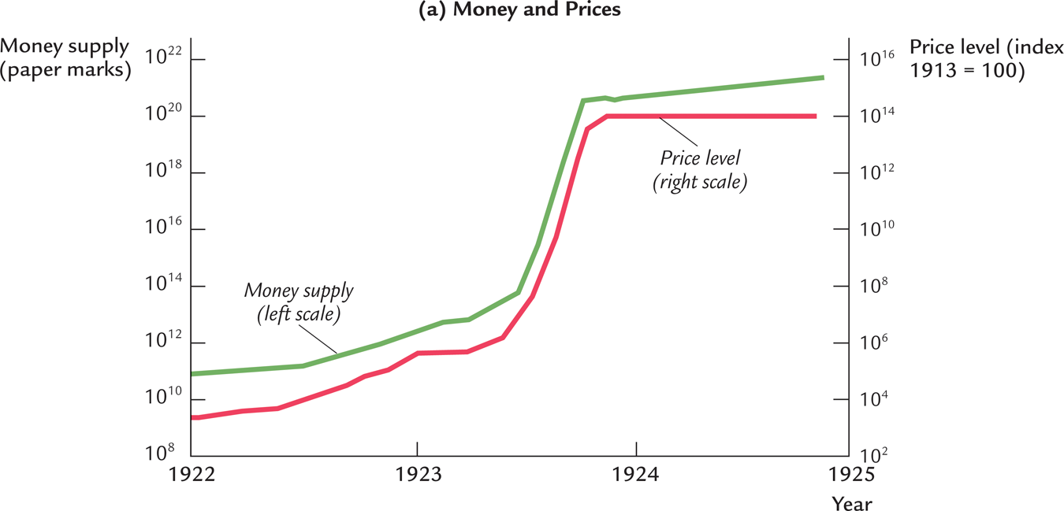
Hyperinflation in Interwar Germany

Slide 58
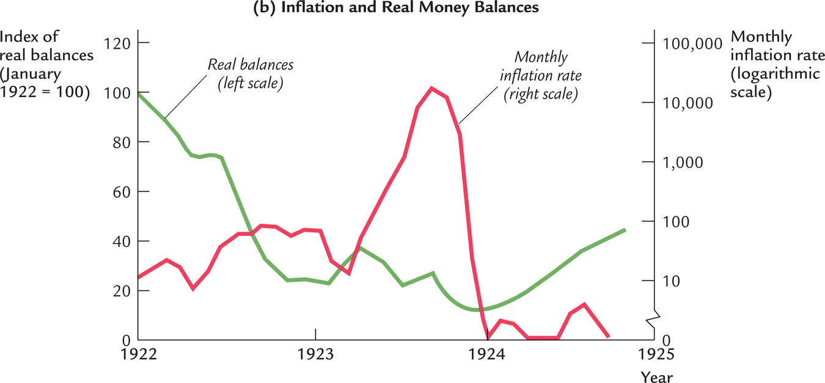
Hyperinflation in Interwar Germany

Slide 59
The Classical Dichotomy
Real variables: Measured in physical units – quantities and relative prices, for example:
  quantity of output produced
  real wage: output earned per hour of work
  real interest rate: output earned in the future
  by lending one unit of output today
Nominal variables: Measured in money units, e.g.,
  nominal wage: Dollars per hour of work.
  nominal interest rate: Dollars earned in future
  by lending one dollar today.
  the price level: The amount of dollars needed
  to buy a representative basket of goods.

Slide 60
The Classical Dichotomy
Note: Real variables were explained in Chap. 3, nominal ones in Chap. 5.
Classical dichotomy:
the theoretical separation of real and nominal variables in the classical model, which implies nominal variables do not affect real variables.
Neutrality of money: Changes in the money supply do not affect real variables.
In the real world, money is approximately neutral in the long run.

Slide 61
CHAPTER SUMMARY
Velocity: the ratio of nominal expenditure to money supply, the rate at which money changes hands
Quantity theory of money
  assumes velocity is constant
  concludes that the money growth rate determines the inflation rate
  applies in the long run
  consistent with cross-country and time-series data
60

Slide 62
CHAPTER SUMMARY
Nominal interest rate
  equals real interest rate + inflation rate
  the opp. cost of holding money
Fisher effect: Nominal interest rate moves
one-for-one with expected inflation.
Money demand
  depends only on income in the quantity theory
  also depends on the nominal interest rate
  if so, then changes in expected inflation affect the current price level.
61

Slide 63
CHAPTER SUMMARY
Costs of inflation
Expected inflation
shoeleather costs, menu costs,
tax & relative price distortions,
inconvenience of correcting figures for inflation
Unexpected inflation
all of the above plus arbitrary redistributions of wealth between debtors and creditors
62

Slide 64
CHAPTER SUMMARY
Hyperinflation
caused by rapid money supply growth when money printed to finance govt budget deficits
stopping it requires fiscal reforms to eliminate
govt’s need for printing money
63

Slide 65
CHAPTER SUMMARY
Classical dichotomy
In classical theory, money is neutral—does not affect real variables.
So, we can study how real variables are determined w/o reference to nominal ones.
Then, money market eq’m determines price level and all nominal variables.
Most economists believe the economy works this way in the long run.
64

