Slide 1
Unemployment
Chapter 7

Slide 2
IN THIS CHAPTER, YOU WILL LEARN:
…about the natural rate of unemployment:
what it means
what causes it
understanding its behavior in the real world
1

Slide 3
Natural rate of unemployment
Natural rate of unemployment:
The average rate of unemployment around which the economy fluctuates.
In a recession, the actual unemployment rate rises above the natural rate.
In a boom, the actual unemployment rate falls below the natural rate.

Slide 4
Actual and natural rates of unemployment, U.S., 1960–2012
Unemployment rate
Natural rate of unemployment
Notes:
Similar to Figure 7-1 in the textbook.
The actual unemployment rate fluctuates considerably over the short run. These fluctuations are the focus of Part IV of the book.
For this chapter, though, our goal is to understand the behavior of the natural rate of unemployment, essentially the long-run trend in the unemployment rate.
Source: BLS, obtained from http://research.stlouisfed.org/fred2/
Unemployment data are based on seasonally-adjusted, monthly unemployment rates for the civilian non-institutional population of the U.S.
The actual u-rate for each quarter is an average of the three monthly unemployment rates in that quarter.
The natural u-rate in a given quarter is estimated by averaging all unemployment rates from 10 years earlier to 10 years later; future unemployment rates are set at 5.5%. (Therefore, estimates of the natural rate may become less accurate toward the end of the sample period.)

Slide 5
A first model of the natural rate
Notation:
L = # of workers in labor force
E = # of employed workers
U = # of unemployed
U/L = unemployment rate

Slide 6
Assumptions:
1. L is exogenously fixed.
2. During any given month,
s = rate of job separations,
fraction of employed workers
that become separated from their jobs
f = rate of job finding,
fraction of unemployed workers
that find jobs
s and f are exogenous
Notes:
This slide spells out the three variables we assume to be exogenous:
the labor force, the rate of job separations, and the rate of job finding.

Slide 7
The transitions between employment and unemployment
s ×E
Employed
Unemployed
f ×U
Notes:
Figure 7-2, p. 179
(Note: The size of the boxes containing the words “employed” and “unemployed” are not proportional to the number of people in each category.)

Slide 8
The steady state condition
Definition: the labor market is in
steady state, or long-run equilibrium,
if the unemployment rate is constant.
The steady-state condition is:
s ×E = f ×U
# of employed people who lose or leave their jobs
# of unemployed people who find jobs
Notes:
In order for the unemployment rate to be constant, the number of people who become unemployed in each month must equal the number of formerly unemployed people who find jobs.

Slide 9
Finding the “equilibrium” U rate
f ×U = s × E
= s × (L – U )
= s × L – s × U
Solve for U/L:
(f + s) × U = s × L
so,

Slide 10
Example:
Each month,
  1% of employed workers lose their jobs
  (s = 0.01)
  19% of unemployed workers find jobs
  (f = 0.19)
Find the natural rate of unemployment:

Slide 11
Policy implication
A policy will reduce the natural rate of unemployment only if it lowers s or increases f.
In case it affects both, it reduces the natural rate of unemployment if it increases f/s, because

Slide 12
Why is there unemployment?
If job finding were instantaneous (f = 1),
then all spells of unemployment would be brief, and the natural rate would be near zero.
There are two reasons why f < 1:
  1. job search
  2. wage rigidity
2010 Nobel Prize in Economics: to Diamond, Mortensen and Pissarides for their analysis of markets with search frictions

Slide 13
Job search & frictional unemployment
frictional unemployment: caused by the time
it takes workers to search for a job
occurs even when wages are flexible and there are enough jobs to go around
occurs because
  workers have different abilities, preferences
  jobs have different skill requirements
  geographic mobility of workers not instantaneous
  flow of information about vacancies and job candidates is imperfect

Slide 14
Sectoral shifts
def: Changes in the composition of demand among industries or regions.
example: Technological change
more jobs repairing computers,
fewer jobs repairing typewriters
example: A new international trade agreement
labor demand increases in export sectors, decreases in import-competing sectors
These scenarios result in frictional unemployment
Notes:
Sometimes the unemployment caused by sectoral shifts is severe.
Due to increasing imports of cheaper foreign-made textiles (particularly since the expiration in 2005 of long-standing quotas on textiles from China), the U.S. textile industry has been in decline for years. Tens of thousands of workers in this industry have lost jobs.
Many of these workers are in their 50s and have worked in this industry for decades. Such workers are unlikely to have the skills necessary to get jobs available in newly booming industries, and they are less likely to invest in the acquisition of the necessary skills for these jobs. Hence, such workers are at greater risk for becoming “discouraged workers.”

Slide 15
CASE STUDY:
Structural change over the long run, U.S.
Notes:
All figures are industry shares in U.S. GDP. “Other industry” includes construction, mining, electricity, water, and gas.
From 1960 to 2009, there are huge changes in all four categories.
Manufacturing falls by about half.
Even the “tiny” category of agriculture drops by about three-fourths.
As a result of these huge structural shifts, the types of jobs available now are vastly different than just two generations ago.
Source: World Development Indicators, World Bank.
[2009 is the latest available as of 2012(!)]

Slide 16
More examples of sectoral shifts
Industrial revolution (1800s):
agriculture declines, manufacturing soars
Energy crisis (1970s):
demand shifts from larger cars to smaller ones
Health care spending as % of GDP:
1960: 5.2 2000: 13.8
1980: 9.1 2010: 17.9
In our dynamic economy,
smaller sectoral shifts occur frequently, contributing to frictional unemployment.
Notes:
Most of the examples on this and the previous slides are big changes that have occurred over many years. Perhaps more important for the natural rate, though, are the many smaller changes that occur more frequently. Ours is a dynamic economy: the structure of demand is shifting almost continuously, due to changes in preferences, technology, and the location of production.
As a result, there is a near-continual flow of newly frictionally unemployed workers.
Sectoral shifts are distinct from recessions (which also cause unemployment). In recessions, there is a general fall in demand across industries, and the unemployment that results is cyclical. Sectoral shifts, though, are changes in the composition of demand across industries, and lead to frictional unemployment as described above.
Source of health expenditure data:
http://www.cms.hhs.gov/NationalHealthExpendData/02_NationalHealthAccountsHistorical.asp#TopOfPage

Slide 17
Public policy and job search
Govt programs affecting unemployment (trying to increase f) include:
  Govt employment agencies
  disseminate info about job openings to better match workers & jobs.
  Public job training programs
  help workers displaced from declining industries get skills needed for jobs in growing industries.

Slide 18
Unemployment insurance (UI)
UI pays part of a worker’s former wages for a limited time after the worker loses his/her job.
UI increases search unemployment,
because it reduces
  the opportunity cost of being unemployed
  the urgency of finding work
  f
Studies: The longer a worker is eligible for UI,
the longer the average spell of unemployment.

Slide 19
Benefits of UI
By allowing workers more time to search,
UI may lead to better matches between
jobs and workers,
which would lead to greater productivity and higher incomes,
And can also lead to longer lasting worker-job matches once unemployed has found a job.
Some studies show that generous UI lowers unemployment in the long run.

Slide 20
Rigidity of job protection
The government may try to reduce s by raising firing costs
International comparison:
  Southern Europe: rigid (high firing costs)
  Central and northern Europe: intermediate
  Anglo-saxon countries: flexible (low firing costs)
Due to firing costs, replacing an employee with a lower wage outsider is costly

Slide 21
Effects of rigid job protection
Finding a job becomes harder:
  if f ↓ at the same rate as s ↓, the natural rate of unemployment is unaffected, but
senior jobs become more stable
youth unemployment increases
unemployment duration increases
insiders enjoy a protection rent (safer and better paid jobs), which makes job finding more difficult for outsiders

Slide 22
Why is there unemployment?
The natural rate of unemployment:
Two reasons why f < 1:
  1. job search
  2. wage rigidity
DONE ✓
Next ➔

Slide 23
Unemployment from real wage rigidity
Real wage
Supply
If real wage is stuck above its equilibrium level, there aren’t enough jobs to go around.
Unemployment
Rigid
real
wage
Demand
Labor
Amount of
labor hired
Amount of labor willing to work
Notes:
Figure 7-3 on p.183.
Abbreviation: “eq’m” = equilibrium

Slide 24
Unemployment from real wage rigidity
If real wage is stuck above its equilibrium level, there aren’t enough jobs to go around.
Then, firms must ration the scarce jobs among workers.
Structural unemployment: The unemployment resulting from real wage rigidity and
job rationing.

Slide 25
Reasons for wage rigidity
1. Minimum wage laws
2. Labor unions
3. Efficiency wages

Slide 26
1. The minimum wage
The min. wage may exceed the equilibrium wage of unskilled workers, especially teenagers.
Studies: a 10% increase in min. wage
in the U.S. reduces teen employment by 1–3%
But, the min. wage cannot explain the
majority of the natural rate of unemployment,
as most workers’ wages are well above
the min. wage.
Notice that there is no minimum wage in Italy

Slide 27
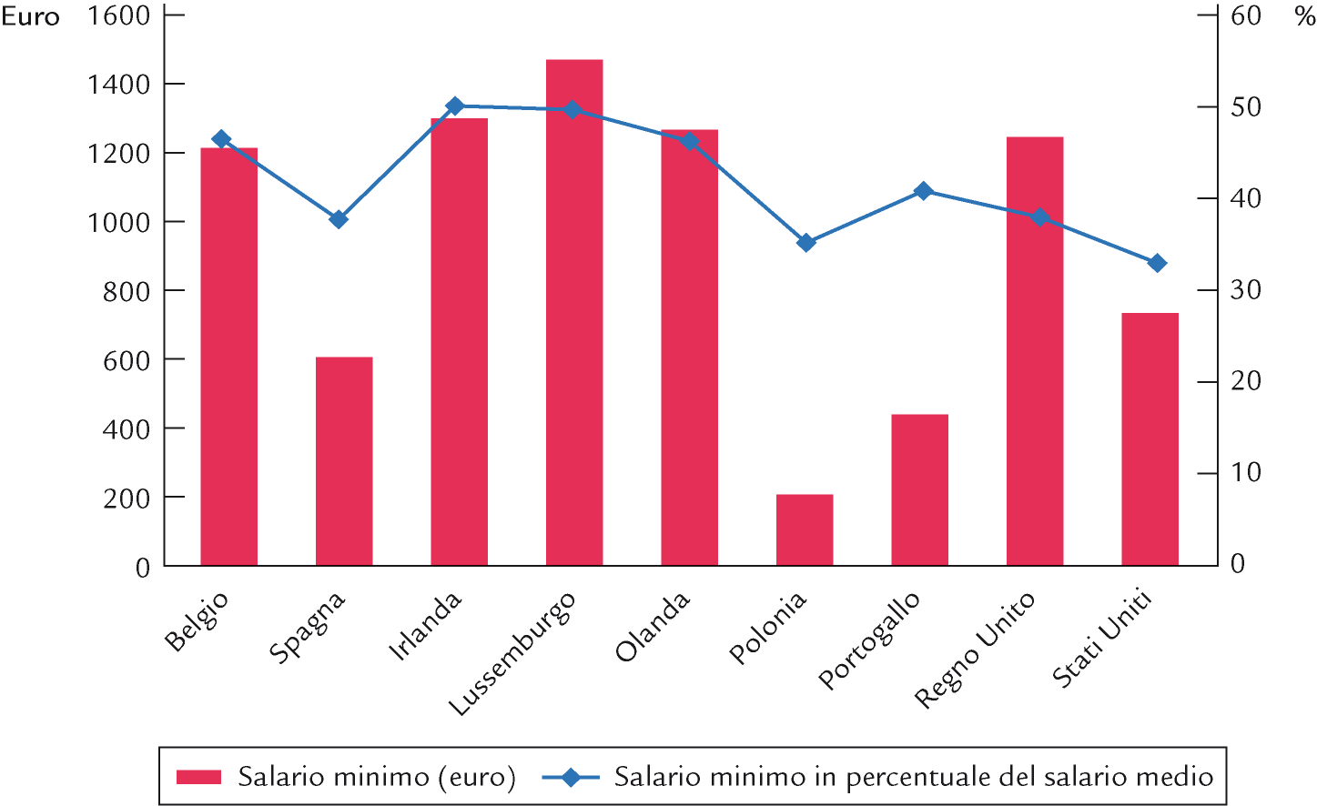
Minimum wages in 2005

Slide 28
2. Labor unions
Unions exercise monopoly power to secure higher wages for their members.
When the union wage exceeds the equilibrium wage, unemployment results.
Insiders: Employed union workers whose interest is to keep wages high.
Outsiders: Unemployed non-union workers who prefer equilibrium wages, so there would be enough jobs for them.
Notes:
See p.187 for more discussion about insiders and outsiders.
The theory has two implications we can confront with data:
1) Union members’ average earnings should be higher than non-union members’ average earnings.
2) The difference between union and non-union wages should be higher in industries that are more heavily unionized (and hence, in which unions have more market power) than in less heavily unionized industries.
The following slide shows recent data on union membership and wage ratios by industry in the U.S. The data are consistent with the theory.

Slide 29
Percent of workers covered by collective bargaining, selected countries
United States | 13%
United Kingdom | 35
Switzerland | 48
Spain | 80
Sweden | 92
Germany | 63
France | 95
Greece | 85
Italy (estimate) | ∼ 80
Notes:
Table 7-1
Source: OECD.

Slide 30
Union membership and wage ratios by industry, 2011
industry
# employed (1000s)
Union % of total
wage ratio
Private sector (total)
104,737
6.9
122.6
Government (total)
20,450
37.0
121.1
Construction
6,244
14.0
151.7
Mining
780
7.2
96.4
Manufacturing
13,599
10.5
107.2
Retail trade
14,582
4.9
102.4
Transportation
4,355
20.4
123.5
Finance, insurance
6,111
1.1
90.2
Professional services
12,171
2.1
99.1
Education
4,020
13.0
112.6
Health care
15,835
7.5
114.9
wage ratio = 100 × (union wage) / (nonunion wage)

Slide 31
3. Efficiency wages
Theories in which higher wages increase worker productivity by:
  attracting higher quality job applicants
  increasing worker effort, reducing “shirking”
  reducing turnover, which is costly to firms
  improving health of workers
  (in developing countries)
Firms willingly pay above-equilibrium wages to raise productivity.
Result: structural unemployment.

Slide 32
Shirking model by Shapiro and Stiglitz
= fixed labour force, and
- N = unemployment.
At N₁ employment is low and unemployment = - N₁ is high; so wage that ensures no shirking is relatively low at w₁.
- N₂ is low
At N₂ employment is high and unemployment = - N₂ is low ⇒ wage that ensures no shirking is relatively high at w₂. We can find a unique wage ensuring no shirking at any level of employment. The locus of all these wages gives the non-shirking condition boundary (NSCB). Points above and on NSCB are making up the non-shirking region.

Slide 33
Henry Ford and efficiency wages
1908-1913: from 450 to 14,000 workers
1913: 370% turnover, 10% absenteism
1914: from 9 to 8 hours/day, doubling the wage (from 2.34 to 5 dollars a day)
Turnover fell to 16% in 1915!
Absenteism to 2.5%
Productivity increased between 40% and 70%
And profits increased

Slide 34
The duration of unemployment
The data:
  More spells of unemployment are short-term than medium-term or long-term.
  Yet, most of the total time spent unemployed is attributable to the long-term unemployed.
This long-term unemployment is probably structural and/or due to sectoral shifts among vastly different industries.
Knowing this is important because it can help us craft policies that are more likely to work.

Slide 35
The Median Duration of U.S. Unemployment
The duration of unemployment typically rises in recessions—but its rise in 2008–2010 is unprecedented.
Weeks
Notes:
This graph replicates Figure 7-4 on p.191. It’s new to the 8th edition, which also includes some nice discussion of different perspectives on the recent rise in long-term unemployment. There are good quotes from Robert Barro and Paul Krugman.

Slide 36
TREND: The natural rate rises over 1960–84, then falls over 1985–2005
Notes:
The purpose of this slide is to establish the trend behavior of the natural rate in recent decades: rising until the early 80s, then falling from the mid-80s through the early 2000s.
(It is probably too soon to say what happened to the trend in 2008-2010, due to the steep recession and to the fact that the natural rate data used in this graph were estimated as the average of unemployment rates from 10 years before to 10 years after each date, with future unemployment rates set at 5.5 percent.)
The following slides will show that the theories in this chapter are (mostly) consistent with the trend behavior of the natural rate.
The graph on this slide is similar to Figure 7-1 (near the beginning of this PowerPoint presentation), with modifications to the vertical scale and colors to highlight the trend behavior.

Slide 37
EXPLAINING THE TREND:
The minimum wage
The real minimum wage and natural u-rate have similar trends.
$
trend
minimum wage in 2012 dollars
minimum wage in current dollars
Notes:
The trend in the real minimum wage rises until the mid to late 1970s, then falls. This is fairly similar to the trend of the natural rate of unemployment.
The U.S. Department of Labor has lots of good information on the minimum wage, at: http://www.dol.gov/dol/topic/wages/minimumwage.htm
[Two sources of data on the federal minimum wage are slightly different in the late 1960s. These small differences have no significant impact on the trend, or the message of this graph.]

Slide 38
EXPLAINING THE TREND:
Union membership
Since early 1980s, the natural rate and union membership
have both fallen.
But, from 1950s
to about 1980,
the natural rate rose while union membership fell.
Union membership selected years
year | percent of labor force
1930 | 12.0
1945 | 35.0
1954 | 35.0
1970 | 27.0
1983 | 20.1
2011 | 11.8
Notes:
A table on an earlier slide showed a positive correlation between the union wage premium and union members’ share of the labor force across industries.
We would expect a similar relationship over time in the aggregate data: as the ratio of union members to all workers rises (falls), the union wage premium and hence natural rate of unemployment should also rise (fall).
The data since the early 1980s are consistent with this expectation. However, the data from the 1950s to the early 1980s are not: the natural rate rose, but union membership declined.
Does the inconsistency from the 1950s to the early 1980s mean the theory is irrelevant? Not necessarily, as other determinants of the natural rate were not constant during the period.
source:
AFL-CIO website, http://www.aflcio.org
and Current Population Survey, Bureau of Labor Statistics

Slide 39
EXPLAINING THE TREND:
Sectoral shifts
2006–2011:
oil price volatility increases –
will the natural u-rate rise again?
1986–2005: oil prices less volatile, so fewer sectoral shifts
1970–1986: volatile oil prices create jarring sectoral shifts
Price per barrel of oil,
in 2011 dollars
Notes:
Earlier in the chapter, we learned that sectoral shifts are a source of job separations and lead to frictional unemployment. One would expect that a decrease in the frequency and magnitude of sectoral shifts would be associated with fewer job separations, less frictional unemployment, and a lower natural rate of unemployment.
Unfortunately, there is no single “index of sectoral shifts.” However, we know that large changes in oil prices are one important source of sectoral shifts. A significant fall in the price of oil causes a decrease in demand for workers at oil fields in Oklahoma and Texas, and an increase in demand for workers at factories that produce SUVs. A significant increase in oil prices would do the opposite.
The graph shows data on the price of oil since 1965.
During 1970-1985, the real price of oil fluctuated between $20 and $100.
Also during this time, the natural rate of unemployment was rising.
During 1986-2002, the real price of oil was in the $20-40 range except for a brief spike during the Gulf War. Also during this time, the natural rate of unemployment was falling.
The data are roughly consistent with the notion that sectoral shifts contribute to the natural rate.
Note the recent increase in oil prices: from about $22 to $70 during 2002-2006:1. This represents a sectoral shift and may contribute to an increase in the natural rate of unemployment. Or maybe not, as oil consumption per dollar of GDP is lower today than in the 1970s and 1980s.
source: Dow Jones & Company
obtained from: http://research.stlouisfed.org/fred2/

Slide 40
EXPLAINING THE TREND:
Demographics
1970s:
The Baby Boomers were young.
Young workers change jobs more frequently (high value of s).
Late 1980s through today:
Baby Boomers aged. Middle-aged workers change jobs less often (low s).
Notes:
For more details on this, see the book.

Slide 41
Unemployment: U.S. and Europe, 1963-2010
Percent of labor force
Notes:
Source: OECD

Slide 42
Why unemployment rose in Europe but not the U.S.
Shock
Technological progress has shifted labor demand from unskilled to skilled workers in recent decades.
Effect in United States
An increase in the “skill premium” – the wage gap between skilled and unskilled workers.
Effect in Europe
Higher unemployment, due to generous govt benefits for unemployed workers and strong union presence.

Slide 43
… until the 2008 crisis
With the 2008 crisis, more flexible countries have witnessed higher layoffs, bringing U.S. and European unemployment rates to converge
For the future, one might expect faster job creation in flexible countries, but that remains to be seen

Slide 44
Unemployment in Europe, 1960–2011
Percent of labor force
Notes:
Figure 7-5 on p.195.
Source: Bureau of Labor Statistics,
http://www.bls.gov/fls/home.htm

Slide 45
Unemployment in Europe, 1984-2010
Percent of labor force
Notes:
Source: OECD

Slide 46
Social and political equilibria
Job protection and family values
  If parents have stable jobs and income, but children do not (and have low job finding rates), they will stay longer at home with parents
If insiders are the majority (or are powerful enough), they will block any attempt to remove their rent
  If protections are removed to outsiders but not to insiders, non protected groups may revolt

Slide 47
Labor market reforms in Europe
Many European countries have increased flexibility for new employed in the Nineties
  Flexibilization at the margin
Objectives
  Increase productivity
  Reduce youth unemployment
  Reduce general unemployment
  Reduce the shadow economy
  Without touching insiders’ rents

Slide 48
Labor market reforms in Europe
Risks:
  Delayed independence, insecurity, difficulty to make long run plans
  Intergenerational clash
  Discouraging firms’ investment in employees

Slide 49
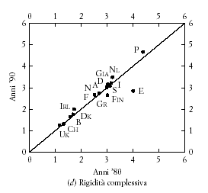
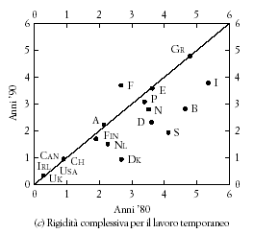
Flexibilization at the margin
Rigidity in the 80’s (horizontal) and 90’s (vertical)
Permanent jobs Temporary jobs

Slide 50
Youth Unemployment
Extensions and explanations
Youth unemployment in the mediterranean countries of the EU

Slide 51
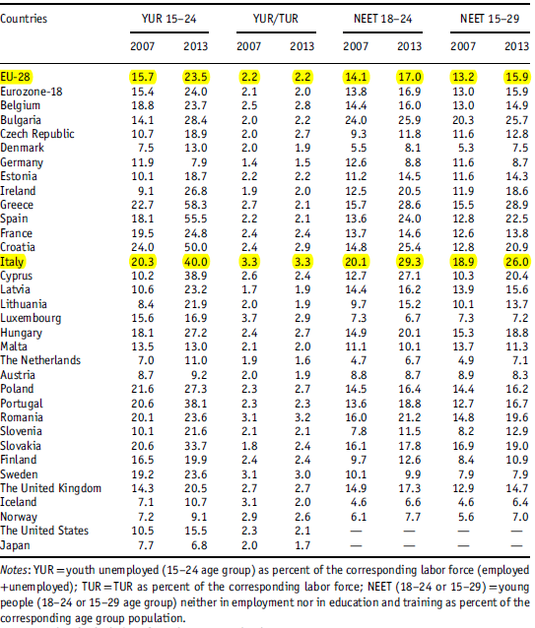
Youth unemployment and NEET during the crisis
Source: Brada et al. 2014

Slide 52
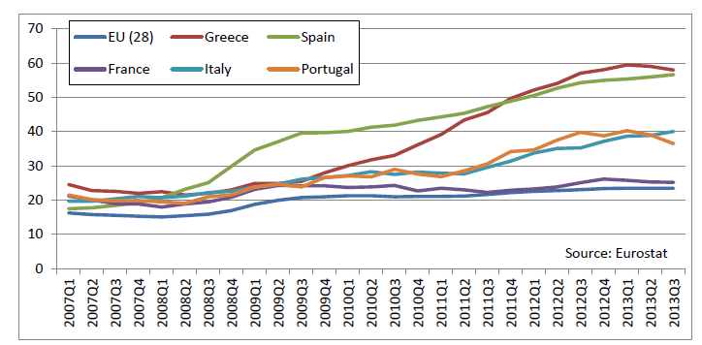
Youth unemployment rate (15-24) in Mediterranean countries

Slide 53
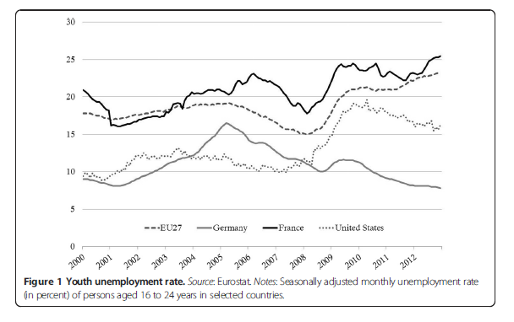
Youth unemployment rate – counterexamples:
EU 27, Germany, France, United States

Slide 54
The youth unemployment rate:
Two caveats
The young can be divided in two groups:
  “teenagers“ (15-19): many are at school; if instead they are in the labor force, they have low skills and it is very difficult for them to find work
  “twens“ (20-24): if they are part of the labor force, they have normally received a secondary or university education and they search for full time jobs
Only a low fraction the young constitutes part of the labor force (in Europe ≈10 %)
    ⇒ It is more relevant to consider the ratio of the number of the young unemployed over the youth population
(youth unemployment ratio)

Slide 55
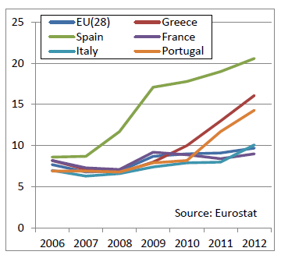
Ratio of young unemployed and youth population

Slide 56
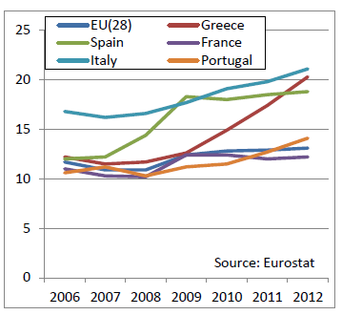
The NEET Rate (15-24)
(NEET=not in employment, education or training)

Slide 57
Youth unemployment : general factors
On average, young workers have less experience and skills: in recessions there are more exposed to the risk of losing their job than older workers
Importance of demographic factors (immigration, fertility rates, …) and, above all institutional factors
  Dual labor market, with temporary and permanent jobs (with different levels of protection for workers) ⇒ for the employer it is costly to transform temporary into permanent jobs (jobs act tried to adress this)
  Role of professional/vocational education is marginal (when it exists it is school-based, not enterprise-based)

Slide 58
Youth unemployment in Italy: a difficult transition from school to work
Reasons
Educational system is rigid and sequential
It does not close the experience gap of young workers
The educational system and the labor market are disconnected
Education is geared towards theory rather practical applications
The skills provided by the educational system often do not correspond to the skills required by firms
Occupation and “Over-education”( e.g., in Italy 23% of university graduates do work that could be done by high school graduates)
In contrast to North-european countries, the Italian state is absent in the transition to adulthood and work (see, e.g., the study by Alesina and Ichino: “Italia fatta in casa”!)

Slide 59
Low youth unemployment in Austria, Denmark, Germany and Switzerland
Reasons
Broad and decisive concerted efforts, supported by strong governments between trade unions and employers’ associations to close the experience gap between young and older workers
Dual educational system: professional/vocational schools, with education inside firms in the form of apprenticeships ⇒ workers acquire required skills directly from the firms
Many youngsters decide to undertake applied studies after finishing the required 10 years of mandatory schooling (e.g., in Germany 40% of students decide to become apprentices)
The transition to permanent contracts is simpler; obviously in the interest of firms to hire the persons that have been trained by them for 3 years (in Germany 90% of apprentices receive a permanent contract offer from their firm)
This institutional asset reduces youth unemployment AND creates a highly qualified labor force. One major caveat, though – low social mobility!

Slide 60
CHAPTER SUMMARY
1. The natural rate of unemployment
  definition: the long-run average or “steady state” rate of unemployment
  depends on the rates of job separation and job finding
2. Frictional unemployment
  due to the time it takes to match workers with jobs
  may be increased by unemployment insurance
59

Slide 61
CHAPTER SUMMARY
3. Structural unemployment
  results from wage rigidity: the real wage remains above the equilibrium level
  caused by: minimum wage, unions, efficiency wages
4. Duration of unemployment
  most spells are short term
  but most weeks of unemployment are attributable to a small number of long-term unemployed persons
60

Slide 62
CHAPTER SUMMARY
5. Behavior of the natural rate in the U.S.
  rose from 1960 to early 1980s, then fell
  possible explanations:
  trends in real minimum wage,
  union membership, prevalence of sectoral shifts, and aging of the Baby Boomers
61

Slide 63
CHAPTER SUMMARY
6. European unemployment
  has risen sharply since 1970
  probably due to generous unemployment benefits, strong union presence, and a technology-driven shift in demand away from unskilled workers
62

