Slide 1
Chapter 16
The government debt

Slide 2
The government debt
What we cover
Government debt: what is it and how does it arise?
The importance of debt: how large is it and how does it change over time?
Are government securities wealth?
When the debt is too large: what does it mean that it is unsustainable?
When the debt is unsustainable: what can be done?

Slide 3
The government debt
What is it and how does it arise? 1 – Deficit and debt
The government decides to have government expenditures equal to G’
It can finance it entirely with tax revenues T:
G’ – T = 0 ↔ government budget is balanced
Or it can decide to finance it partially by issuing debt, ∆D:
G’ – T = ∆D>0 ↔ budget is in deficit .
The deficit is financed by issuing debt, ∆D.
In the next period:
If G’ and T remain constant, there is nevertheless a new expenditure item:
i D ↔ interest payments on the stock of debt, valued at the beginning of the period
(G’ + i D ) – T = G – T = ∆D
Where : i = coupons on already issued securities , equal to nominal interest rate.

Slide 4
The government debt
What is it and how does it arise? 2 – Reasons for choosing debt financing
Why would a government decide to use debt financing to finance part of government expenditures?
Three reasons:
If the expenditures are for a public investment, which will produce benefits for many years, it seems natural to distribute the burden over several periods.
Issuing debt is equivalent to transfer the cost of expenditures to future financial years and sometimes also to future generations.
The government might want to engage in debt financing also when it finances current expenditures (government consumption or transfer payments) :
Larger transfer payments increase the support for the government
Not increasing taxes ensures that the other citizens (those not receiving transfer payments) are not alienated
The government might increase expenditures or lower taxes to stabilize the economy, i.e., for macroeconomic reasons.

Slide 5
The government debt
What is it and how does it arise? 3 – Total and primary deficit
Definitions:
G’ – T > 0 : primary deficit
G’ – T < 0 : primary surplus
(G’ + i D) – T = G – T > 0 : total deficit
(G’ + i D) – T = G – T < 0 : total surplus
To be able to contain the growth of government debt, it is necessary to maintain a primary surplus.
Otherwise, the government would have to issue new debt every year:
To finance the new primary deficit
To pay interest on the already issued debt

Slide 6
The government debt
What is it and how does it arise? 4 – Who buys the debt
The newly issued government securities are «offered» (by the Treasury) on the primary market (the «auctions» of government securities).
The government securities issued in the past are traded on the secondary market.
Who holds government securities? The savers (national or foreign):
Directly
Indirectly, through financial intermediaries:
Banks, investment funds, insurance companies, pension funds

Slide 7
The government debt
What is it and how does it arise? 5 – channels of saving through which debt is acquired
Let us remember that:
National Saving is: S = Y – C – G = I + NX
Private Saving is: S^{PR} = Y – C – T = I + G – T + NX
Which we can rewrite: (S^{PR} – I) – NX = G – T
Every newly issued debt, used to finance a government deficit is bought:
By internal private savers, by that part of saving that does not finance investment, or
By foreign savers, through a deficit in the Current Account

Slide 8
Debt/GDP ratio: USA, 1791-2011
The government debt
How large is it and how does it change over time? - 1
Financial crisis
WW II
American Revolution
Reagan & Bush
World War I
Civil War
Notes:
Figure 19-1, p.546.
The historical pattern: the debt–GDP ratio rises during wars and falls during peacetime. The exception is the substantial rise that occurred beginning in the early 1980s.
Source: See textbook.

Slide 9
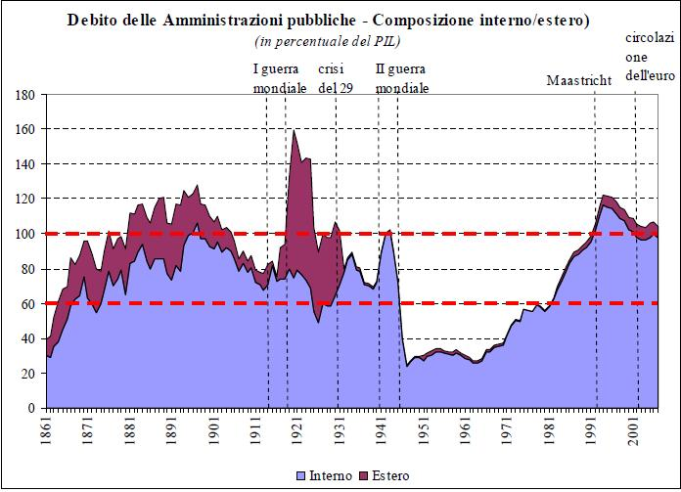
The government debt
How large is it and how does it change over time? - 2
Italy, 1861-2007
Source: Banca d’Italia
Notes:
Figure 19-1, p.546.
The historical pattern: the debt–GDP ratio rises during wars and falls during peacetime. The exception is the substantial rise that occurred beginning in the early 1980s.
Source: See textbook.

Slide 10
Debt/GDP ratio (in %): Europe, 1970-2013
The government debt
How large is it and how does it change over time? - 3
Notes:
Source: OECD - General government gross financial liabilities, % of nominal GDP

Slide 11
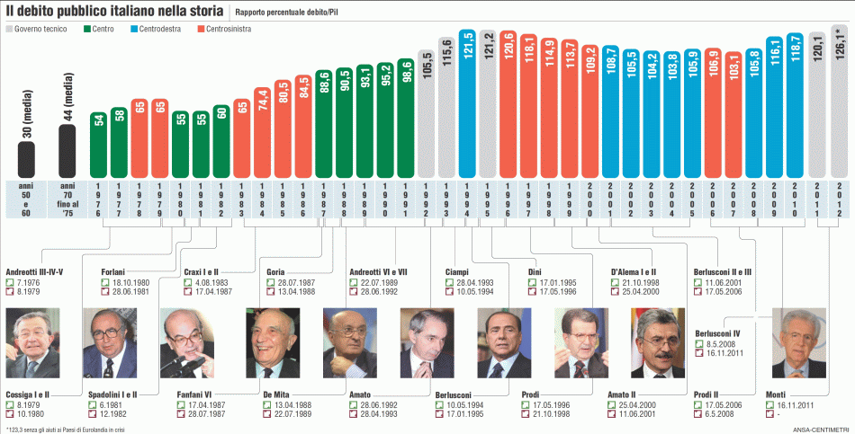
The government debt
How large and how does it change over time? - 4
Source: Soldionline, 17.12.2015
http://www.soldionline.it/infografiche/infografica-la-storia-del-debito-pubblico-italiano
Notes:
Source: OECD - General government gross financial liabilities, % of nominal GDP

Slide 12
The government debt
Do government securities create wealth in the aggregate?
From the point of view of savers, the possession of government securities is a way to hold wealth. But does this mean that they create private wealth?
Let’s make some back-of-the-envelope calculations:
Suppose that the government has an expenditure program where it spends G = 100 per annum, for three years
Let us consider two alternatives:
The expenditures of each year is entirely financed through current taxes (there is no issuing of debt);
In the first two years the expenditures are financed by issuing debt, and only in the third year taxes are collected to pay off the entire debt.
How does the situation differ in the two cases?

Slide 13
Do government securities create wealth in the aggregate? - 2
Remember: disposable income is equal to:Y_{d} = Y – T = C + S^{PR}
Assumption: annual consumption is constant
Values per capita | Expenditures financed with taxes |  |  | Expenditures financed with debt
 | 2015 | 2016 | 2017 | 2015 | 2016 | 2017
GDP | 500 | 500 | 500 | 500 | 500 | 500
Govt spending | 100 | 100 | 100 | 100 | 100 | 100
taxes | 100 | 100 | 100 | 0 | 0 | 315,25 = 100 + 1,05*100+1,05²*100
Disposable income | 400 | 400 | 400 | 500 | 500 | 184,75
Private consumption | 320 | 320 | 320 | 320 | 320 | 320
Private saving | 80 | 80 | 80 | 180 | 180 | - 135,25
Interest rate | 0,05 | 0,05 | 0,05 | 0,05 | 0,05 | 0,05
Private wealth | 80 | 164 = 80 +1,05*80 | 252,2 = 80 +1,05*80 +(1,05²)*80 | 180 | 369 = 180 +1,05*180 | 252,2 = -135,25 +1,05*180 +(1,05²)*180

Slide 14
Do government securities create wealth in the aggregate? - 3
In our example: Government securities do not create wealth!
We actually observe that in both cases:
The level of consumption is the same, in each year
In both cases at the end of 2017 the accumulated wealth is exactly the same: 252,2
If the expenditures are debt financed, in the first two years the consumer does not pay taxes and is hence able to save more and accumulate more wealth ...
But in the end, all the additional accumulated wealth has to be used to pay the larger taxes that are necessary to pay off the debt when it comes due.
So, no Pigou effect (which says:↑ perceived wealth⇒↑ consumption)

Slide 15
Do government securities create wealth in the aggregate? - 4
This result demonstrates the theorem on the neutrality of government debt (R. Barro, 1974), also called the Theorem of Ricardian equivalence
According to Barro, if consumers/savers are rational:
They are able to figure out that whether government expenditures are financed with government securities or with tax revenues, in both cases in the end the total tax burden (including paying back the debt) is exactly the same: hence the final wealth of the savers will be the same in both cases.
Naturally, if the final wealth is the same, the present value (as of today) of wealth is equal in both cases: hence from the beginning (from the first year when the consumer does not pay taxes) the consumer is not fooled: s/he knows that the larger savings today only serve to pay the higher future taxes.

Slide 16
Do government securities create wealth in the aggregate? - 5
Is government debt really always neutral?
The theorem of neutrality of government debt only holds under certain assumptions (which were satisfied in our numerical example). To see this let us have a counter example:
Instead of assuming that the income of consumers is always sufficient to guarantee a constant level of consumption, let us assume that income grows over time.
For example, let us assume that my income is 400 in the first year and 605 in the second year. The present value of the sum of the two incomes is the same as when I earn always 500 in the two years:
400 + 605/1,05 = 500 + 500/1,05 = 976,2
However, when the income is 400 in the first year, and I have to pay taxes of 100 I will not be able to consume at the desired level of 320. In this case, given that total income is the same over the three years it makes a difference to me whether I have to pay the same amount of taxes every year, or whether I can pay the taxes at the end of the period when I will earn more.
As an alternative, in order to always consume 320, I could ask for a loan the sum that is lacking. But in this case the theorem of neutrality only holds if I can go into debt at the same interest rate as the state. But if that is not the case, it is better that the state goes into debt than I do.

Slide 17
Do government securities create wealth in the aggregate? - 6
Is government debt really always neutral? What does our example say on this?
The theorem on the neutrality of government debt is valid if:
Consumers have perfect knowledge and foresight regarding their income and consumption today and in the future (i.e. they are in no way myopic!)
no matter whether expenditures are financed with current or future taxes, the tax burden will fall on the same persons: there are no redistributive consequences linked to the financing method
a) The income of consumers is constant over time, or
b) Consumers can borrow funds in a «perfect» capital market at the same interest rate as the state can borrow funds
When these assumptions do not hold, we can assume that:
At least some consumers prefer to delay the payment of taxes, and if this happens they feel to be at least a little bit «richer».
Consequently these consumers will increase consumption expenditures.
Hence, financing government expenditures through issuing debt, rather than through current taxes, has a larger expansionary effect on aggregate demand.

Slide 18
The government debt
When does it become unsustainable?
Debt is unsustainable when the debtor is no longer able to contain its growth, i.e., when the debtor is constrained to issue new debt only to pay the interest on previously issued debt.
In this case, also the outlays on the interest grows over time and the debt is on a path of ever accelerating growth.
Nota Bene:
Since the ability of the state to pay interest depends on the taxes it can raise and since taxes increase with income, it is natural to evaluate the sustainability of the debt not in terms of its absolute value (billions of Euro) but in terms of the ratio of Debt/GDP.
That’s why the macroeconomic analyses of the sustainablity focus on the ratio of Debt/GDP.

Slide 19
The government debt
When does it become unsustainable? - 2
Example: a comparison of fictitious countries
 | Initial Debt (% GDP) | Interest rate | Annual expenditure on interest (% GDP)
Country A | 60 | 2 | 1,2
Country B | 60 | 5 | 3
Country C | 120 | 5 | 6
Country D | 120 | 12 | 14,4
Country E | 180 | 5 | 9
Country F | 180 | 12 | 21,6
Question: Which primary surplus would be necessary to eliminate the growth of the debt?
→ The primary surplus would have to be equal to the expenditures on the interest. In this case ∆D = 0.

Slide 20
The government debt
When does it become unsustainable? - 3
Example: a comparison of real countries Source: Eur. Comm., AMECO
2014 | Debt 2014 (% GDP) | Expenditures on interest 2015 (% GDP) | Primary surplus (2015)
Germany | 74,7 | 1,6 | 2,2
Ireland | 109,7 | 3,6 | 0,7
Greece | 177,1 | 4,2 | 2,1
Spain | 97,7 | 3,1 | -1,4
France | 95,0 | 2,1 | -1,7
Italy | 132,1 | 4,3 | 1,7
The interest payments of Greece are particularly low, relative to the debt, because the debt was renegotiated with the «Troika» at below market interest rates.

Slide 21
The government debt
When does it become unsustainable? - 4
The previous table demonstrates that only Germany has a primary surplus (in 2015) that is greater than expenditures on interest.
Hence it was the only country in the table that reduced the debt in circulation in 2015 according to the following formula:
∆D = i D + G’ – T (Recall G’ – T <0 ⇒ primary surplus)
which can be rewritten as: ∆D = i D – A , with: A ≡ T – G’
The analysis of the dynamics of the ratio Debt / GDP is, however, more complex
since ∆D is only the change of the numerator in this ratio!

Slide 22
The government debt
The change in the debt to GDP ratio
The change of the ratio between government debt and GDP can be expressed as:
$$∆\left(\frac{D}{Y}\right)$$
From calculus we know: «the change of a ratio is equal to the change in the numerator times the denominator minus the change in the denominator times the numerator, all divided by the denominator squared»,
$∆\left(\frac{D}{Y}\right)≈ \frac{∆D∙Y−∆Y∙D}{Y^{2}}= \frac{∆D}{Y}$ $−$ $\frac{∆Y}{Y}∙\frac{D}{Y}$
We can rewrite this equation, since:
∆D = i D – A is the total deficit,
∆Y/Y = π+γ, is the growth rate of nominal GDP.

Slide 23
The government debt
The change in the debt to GDP ratio - 2
Substituting these two expressions we get:
$∆\left(\frac{D}{Y}\right)= \frac{∆D∙Y−∆Y∙D}{Y^{2}}= \frac{\left[iD − A\right] − \left(\text{π}\text{+}\text{γ}\right)D}{Y}$
Which says: the debt/GDP ratio grows if the total deficit [$iD − A]$ is greater than the product of the growth rate of nominal GDP $\left(\text{π}\text{+}\text{γ}\right)$and the nominal value of the debt (D)
Example (Italy 2015):
Interest payments: € 70,0 bill. - primary surplus: € 27,9 bill.
Total deficit: € 42,1 bill. - Debt at end of 2014: € 2134,9 bill.
Growth rate of nominal GDP: 1,2%
Putting these numbers in the formula: $∆\left(\frac{D}{Y}\right)= \frac{42,1 − 0,012 ∙2134,9}{1616}= \frac{16,5}{1616}=0,01$
Given the debt/GDP ratio at the end of 2014: 132,1% = 1,321
The ratio at the end of 2015: 1,321 + 0,01 = 1,331 = 133,1%

Slide 24
The government debt
The change in the debt to GDP ratio - 3
Reiterating our main results:
The debt of a country grows if the primary surplus is lower than the expenditures on interest payments:
A < i D
The debt/GDP ratio grows if the total deficit is larger than the product of the growth rate of nominal GDP and the debt at the end of the previous year:
i D – A > $\left(\text{π}\text{+}\text{γ}\right)∙D$
The change of the debt/GDP ratio we can calculate with the following formula:
$∆\left(\frac{D}{Y}\right)= \frac{∆D∙Y−∆Y∙D}{Y^{2}}= \frac{\left[i∙D − A\right] − \left(\text{π}\text{+}\text{γ}\right)∙D}{Y}$

Slide 25
The government debt
The change in the debt to GDP ratio - 4
$$∆\left(\frac{D}{Y}\right)= \frac{∆D∙Y−∆Y∙D}{Y^{2}}= \frac{\left[i∙D − A\right] − \left(\text{π}\text{+}\text{γ}\right)∙D}{Y}$$
With the help of the above expression we can propose the following definition of the unsustainability of the debt:
The government debt is unsustainable if, given the growth of nominal GDP, the government is not able (on average over a business cycle) to generate a sufficiently large enough primary surplus that can stop the growth of the debt/GDP ratio,
Or if: $\frac{A }{Y}< \frac{\left[i∙D \right] −\left(\text{π}\text{+}\text{γ}\right)∙D}{Y}$ = $\frac{\left(i − \text{π}\text{ − }\text{γ}\right)∙D}{Y}$

Slide 26
The government debt
What is done when the debt is unsustainable?
When the debt to GDP ratio continues to grow
The buyers of the debt begin to doubt that the state:
Can still pay the interest on the already issued debt
Is in a position to pay off the debt that is coming due.
In this case, there can be two immediate consequences:
Since the buyers of the debt have the perception of an increase in the risk , they will ask for a higher interest rate. This, however, has a counterproductive effect: actually higher interest payments accelerate the growth of the debt!
The more risk averse investors will abandon the auctions of debt emmissions: the state is no longer able to issue new debt, not in order to finance the interest on the old debt nor in order to pay for other expenditures.

Slide 27
The government debt
What is done when the debt is unsustainable? - 2
A this point there are two ways out:
The state asks the Central Bank for help
The central bank intervenes directly in the primary market (market of new emmissions) and acquires the debt that the state is not able to issue otherwise.
Alternatively, the Central Bank can also intervene in the secondary market, acquiring securities already in the hand of private investors and thus raising their prices
This has various consequences:
To acquire the debt the Central Bank prints money («monetizing» the debt)
When circulating in the economy the new money generates a rise in prices, hence we have an increase of nominal GDP: the debt/GDP ratio falls
With the nominal value of the debt fixed and nominal GDP rising, the real value of those securities already in the hands of private investors falls: this is the inflation tax.

Slide 28
The government debt
What is done when the debt is unsustainable? - 3
The second way out:
The state unilaterally proposes a restructuring of the debt
This can occur in various ways:
Total or partial bankruptcy: the state does not acknowledge its own debt, totally or in parts: If it is partial, this might apply to only certain categories of creditors.
E.g.: the debt acquired by non-residents (Russia, 1998), or the internal debt (Argentina, 2001) or the external debt (Argentina, 2005).
Restructuring or renegotiation: the state proposes a swap, that is to substitute already issued securities with securities of a lower value
E.g.: securities with the nominal value corresponding to the market value of old securities that have been devalued during the crisis; securities with the same nominal value as before but with lower coupon rates; securities with the same nominal value but with longer maturity.

Slide 29
The government debt
What is done when the debt is unsustainable? - 4
The second way out:
The state unilaterally proposes a restructuring of the debt - continued
Two important points when this approach is used:
A restructuring of the debt is only feasible once the state has reached a primary surplus: that is, when the state no longer needs to emit securities to pay for expenditures different from interest payments.
In actual fact, after such an operation it takes a few years before investors «forget» and return to lend money to the state in question. Hence, often for some years the state has to be aware that it cannot count on the possibility to issue new debt.
Nearly always a restructuring of the debt is accompanied with a devaluation of the currency (e.g., Russia 1998), in order to increase the external competitiveness and to raise aggregate demand in the country.

Slide 30
Sovereign Bond Defaults, 1997 – 2012 Source: Moody’s Investor Service (2012) Moody’s Sovereign Defaults Series: Investor Losses in Modern-Era Sovereign Bond Restructurings. http://av.r.ftdata.co.uk/files/2012/09/Sovereign-Default-Series-Investor-Losses-in-Modern-Era-Sovereign-Bond-Restructurings.pdf
Initial Default Date/ Country (NR=not rated at the time) | Sequence of Default Events (DE=Distressed Exchange)
1997 Mongolia (NR) | Missed payments
1998 Venezuela | Missed payments
Aug-1998 Russia | Missed payments, DE, Missed payments, DE, DE
Sep-1998 Ukraine | DE, DE, DE, Missed payment, DE, Missed payments, DE
Jul-1999 Pakistan | Grace period missed payment, Missed payment, DE
Aug-1999 Ecuador | Missed payments, DE
Nov-1999 Turkey (NR) | Imposed tax
Mar-2000 Cote d'Ivoire (NR) | Grace period missed payments, Missed payment, DE
Nov-2001 Argentina | Debt swap, DE, Missed payment, Pesoization, DE, Re-open DE
Jun-2002 Moldova | Grace period missed payment, Missed payment, DE
Jan-2003 Paraguay (NR) | Missed payments, DE
May-2003 Uruguay DE | DE
Jul-2003 Nicaragua | DE, DE
Jul-2003 Dominica (NR) | Missed payments, DE
H2-2004 Cameroon (NR) | Missed payments, DE
Dec-2004 Grenada (NR) | Missed payments, DE
Apr-2005 Dominican Republic | Grace period missed payments, DE
Dec-2006 Belize | Missed payments, DE
Jul-2008 Seychelles (NR) | Missed payments, DE
Dec-2008 Ecuador | Missed payments, DE
Feb-2010 Jamaica | DE
Jan-2011 Cote d'Ivoire (NR) | Missed payments, DE, Developing
Nov-2011 St. Kitts and Nevis (NR) | Missed payment, DE, Debt-land swap
Mar-2012 Greece | Retroactive insertion of CACs, DE, Developing
DE : Unilateral substituiton of securities already placed
CAC : Collective Action Clauses

